Slide 1
Better builds and deployments with Azure Pipelines
Jeremy Lindsay
@_jeremylindsay_
http://jeremylindsayni.wordpress.com

Slide 2
What are Pipelines?
A list of instructions to perform on your code
Examples are Compile, Test, Deploy
‘Azure Pipelines’ is a cloud service that combines CI and CD to consistently test and build your code, and ship it to any target

Slide 3
Moving code around is a challenge
Older software builds and deployments might never have been automated
Full automation for most is far in the future
Greenfield projects have challenges too

Slide 4
How do we know when we’re on the right track?
Are the people who write the code the same people who deploy the code?
Do features take days, weeks or hours to get to production?
Do developers use a different tech architecture to the one in production?

Slide 5
Why I like Azure Pipelines
Targets huge range of project types – simplifies retrofitting process
Declarative stages act as build/deployment docs for yourself and others – helps Devs understand and contribute to Ops processes
Not just for technical people – share data with managers and product owners
Low cost – free for open source, 30 build hours/month for private projects

Slide 6
How do I get started with Azure Pipelines?
Part of the ‘Azure DevOps’ suite of products
Register for free at https://dev.azure.com
Azure Devops Demo Generator
Can also purchase the ‘Azure DevOps Server’ software for installation on your own infrastructure
Allows you to clone an entire DevOps project – wiki, work items, code, test plans and pipelines
Useful for getting started and seeing examples, best practices
https://azuredevopsdemogenerator.azurewebsites.net
Sample DevOps projects provided by Microsoft

Slide 7
Video Demonstration
Adding a new pipeline to an existing .NET Core project
Adding static code analysis using SonarQube to the pipeline

Slide 8
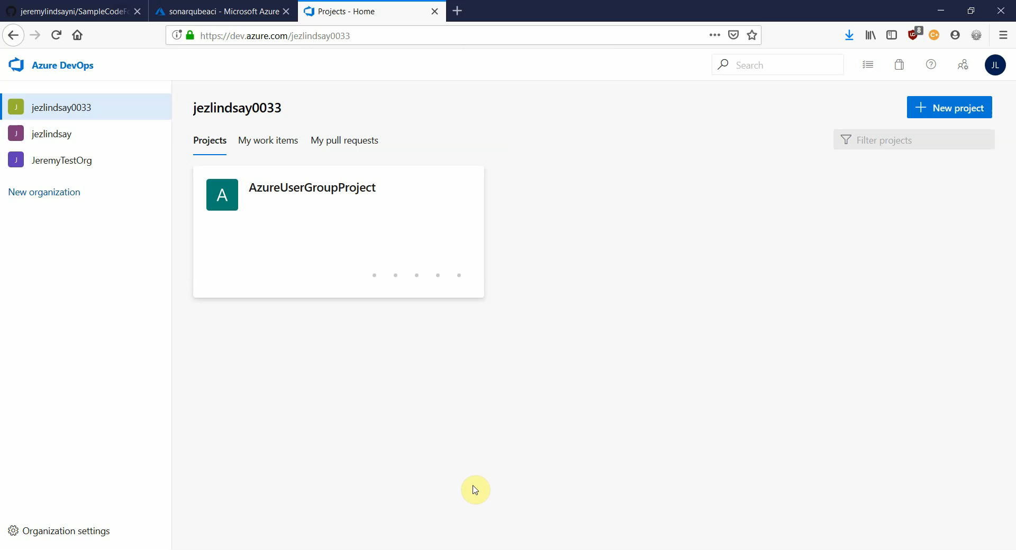

Slide 9
Possible Improvements
Lot of complaints online about the UI and templates
No gated releases in YAML preview
Integration between YAML and classic views could be better
Can be slow
Notes:
UI – opinion based, but does keep changing
Highly requested feature, apparently in development
Possible to burn through 1800 minutes pretty fast, but 11/month for privately hosted agent is ok

Slide 10
Wrapping Up
Azure Pipelines is one of the most versatile CI/CD tools available
Helps lower the Wall of Confusion between Dev and Ops
Integration with Repos/Github/Boards/Private NuGet is a great feature

Slide 11

Thank you

Slide 12
Workshop
Import a C# ASP.NET Core project to Azure Repos
Create a Build Pipeline using a template
Spin up a demo SonarQube container using Docker in Azure
Connect the Build Pipeline to SonarQube to perform static code analysis

Slide 13
https://github.com/jeremylindsayni/SampleCodeForSonarQube
https://bit.ly/2ois1Zm

